Slide 1
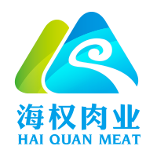
2017
HAI QUAN MEAT FOOD PROCESSING CO., LTD

Slide 2
RATIONALE
Central government document No 1 states that: farming should be gradually shifted to grass-fed husbandry. GUIZHOU province is located at the south-western part of China with grass pasture over 1.183 billion MU (15 MU=1 hectare) . China has a total of 1.8 billion MU of farming land, hence husbandry is the preferred model for China’s agriculture 。
-02-

Slide 3
Contents
01
03
04
04
02
Our company
Husbandry in China
Future plan
Beef Required

Slide 4
01
Our Company’s
focus

Slide 5
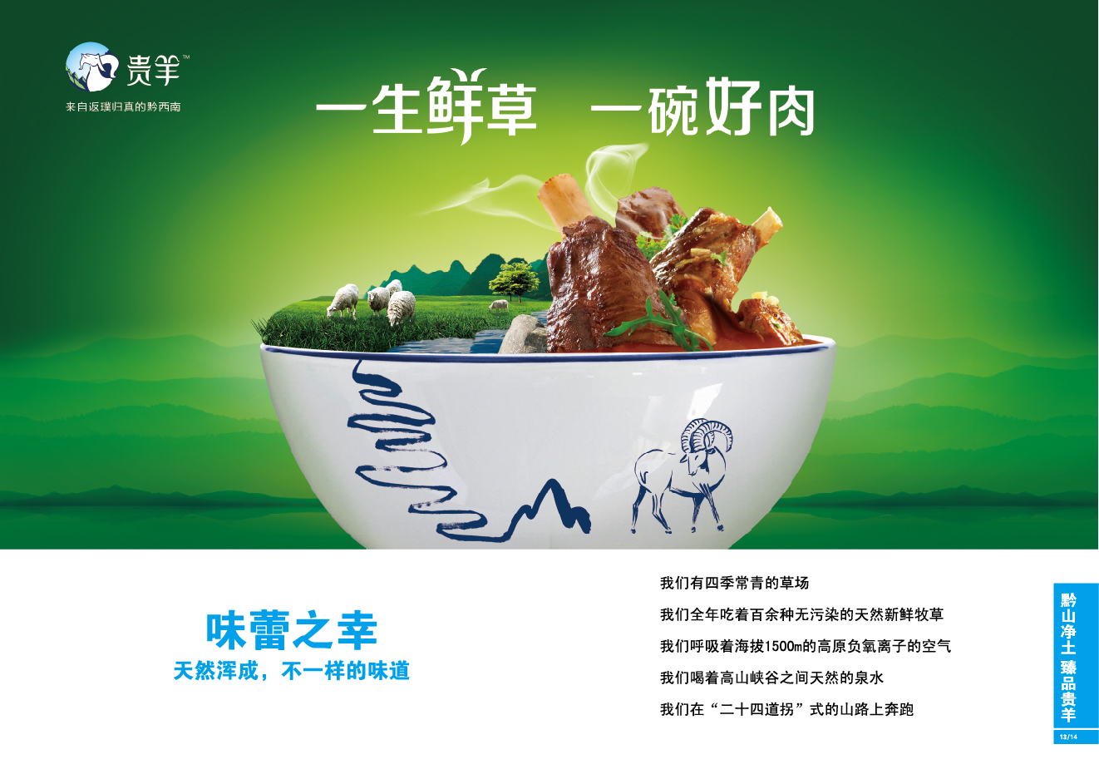
公司简介
HAI QUAN MEAT FOOD PROCESSING CO., LTD
CO., LTD
Hai Quan Meat Food Processing Co., Ltd
Our company was set up on 18 September 2012 with a registered capital of 137 million RMB (about 34 million AUD) Total asset 260 million RMB。
Our company’s first factory is located at QINGLONG with a floor area of 180 MU with a total construction area of 16,000 square meters, annual processing capacity 1.20 million heads

Slide 6
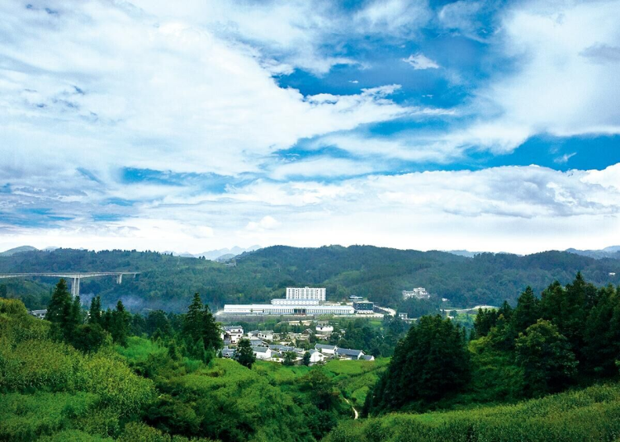
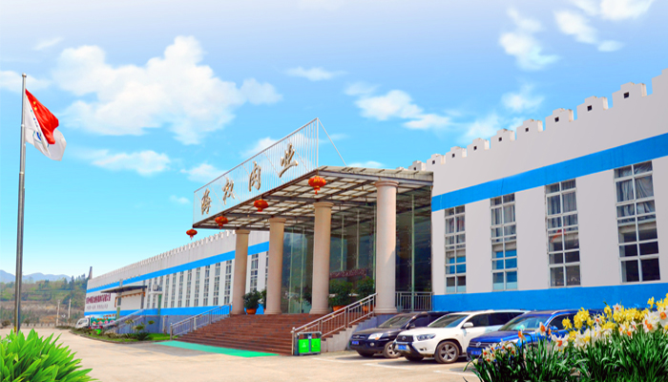
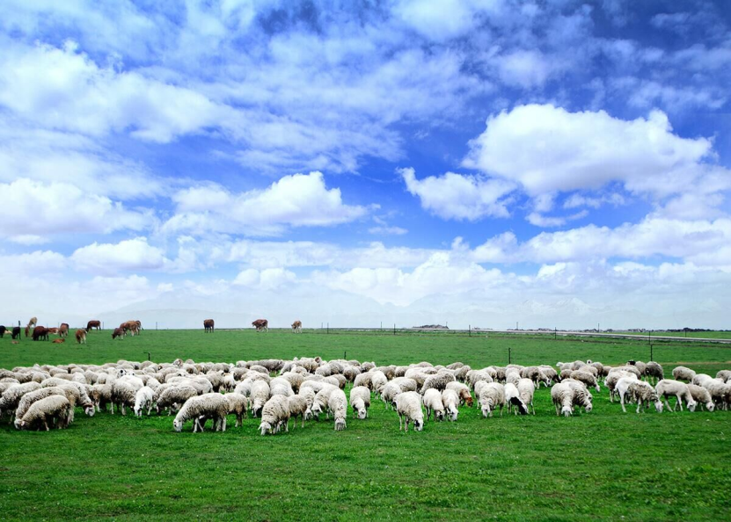
Our Vision
We are poised to develop lamb and beef meat processing as one the
main streams business for promoting “mountain economy” for Guizhou province, thereafter to other provinces . We have developed a perfect
match for eco-husbandry and modernised industrial process – a one –
stop - shop business operation 。

Slide 7
Chronology of our business
2012
2013
2014
2015
2016
Set up in
December
Factory
completed
in November
Production
Commenced
Sale gross
income
Sale gross
income
196 million RMB
(about 39 million AUD)
270 million RMB
(about 56 million AUD)

Slide 8
02
Husbandry in China

Slide 9
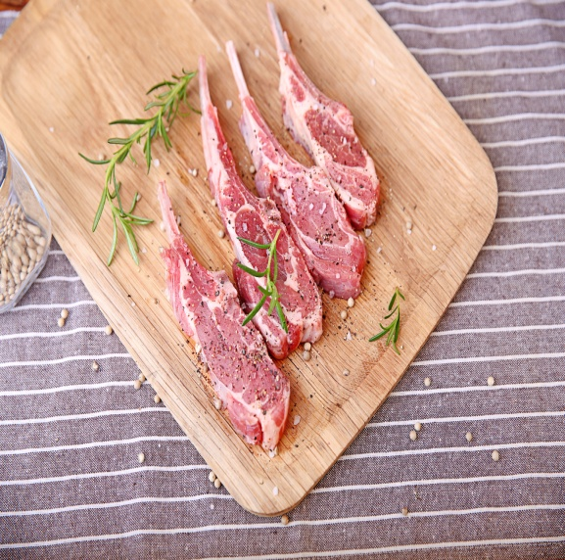
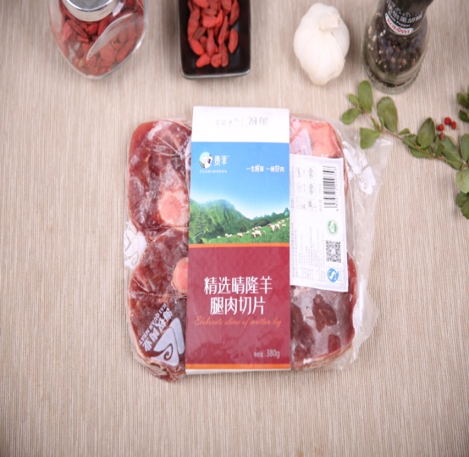
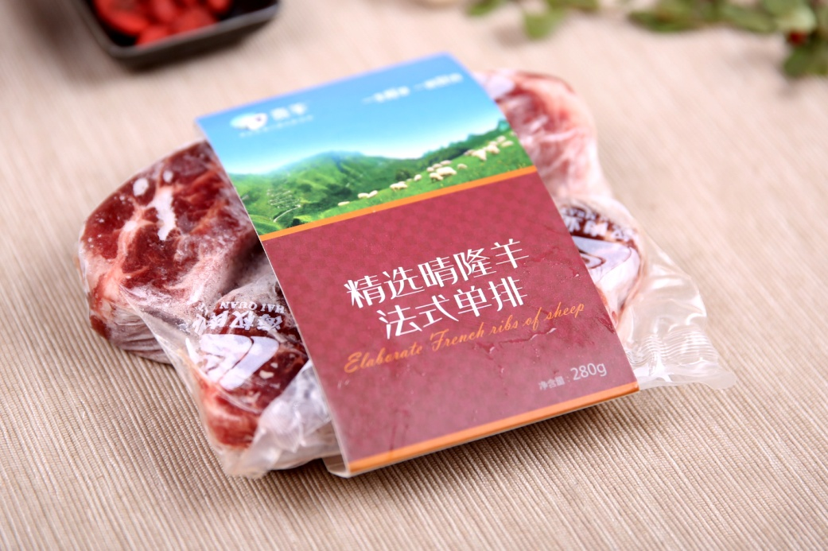
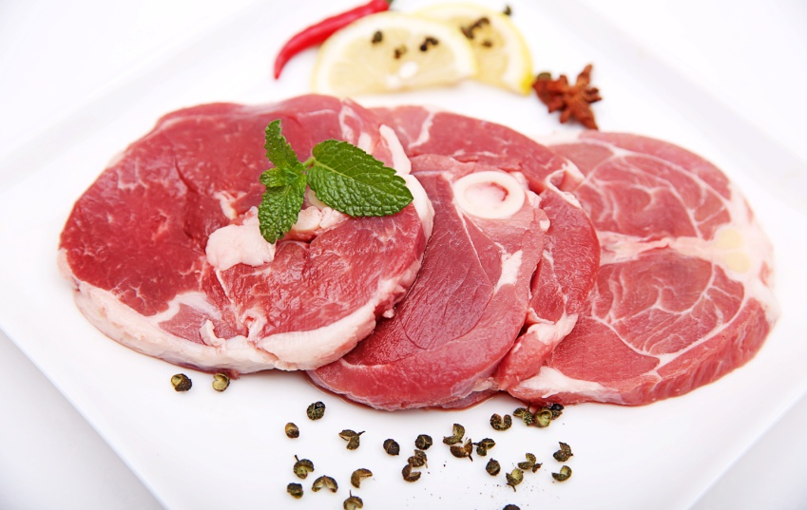
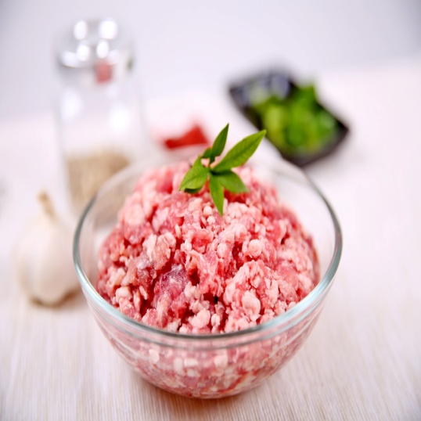
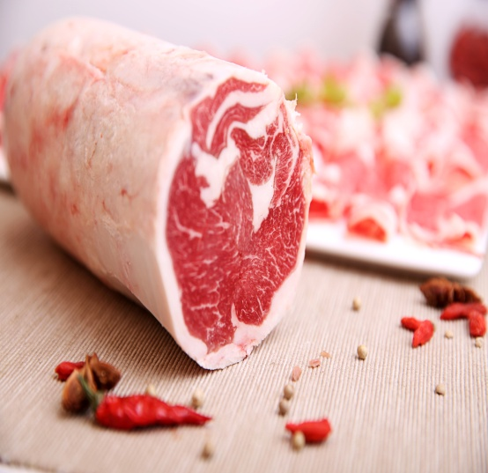
主打产品
Phase 1: Lamb rack（3,000ton/yr）、Lamb roll（8,000 ton/yr）、box chilled lamb meat （18,000ton）、Meat ball, slices products；Phase 2：Cooked meat、breakfast sausages ；Phase 3：bone, blood processing and fertiser 。

Slide 10
Meat business
单位：万美元
单位：万美元
The above on the left is an export chart of meat from China, whereas the above on the right is an import Chart of meat from China. China ranked no. 1 for lamb production and no. 3 on beef, after USA and Brazil. At the moment, due to change of diet and eating habit, the demand for meat, in particular beef has been increasing. We are poised to become a key player in this area。

Slide 11
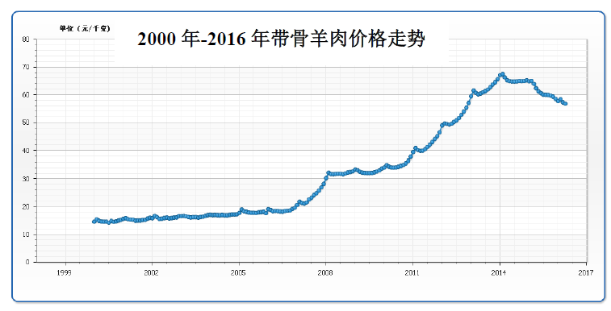
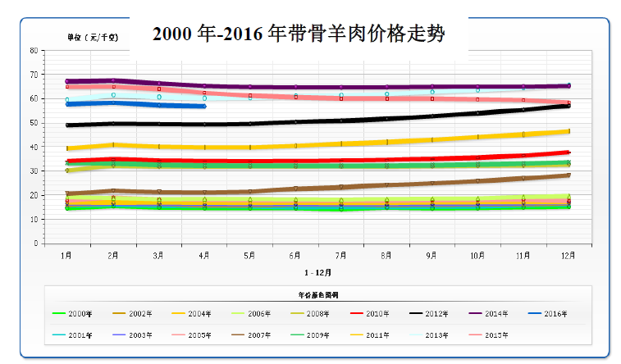
The above demonstrates demand for high quality meat with bone (lamb and beef) has been increasing from 2000-2016

Slide 12
03
Beef required

Slide 13
Beef Required
1、From our retail network
2、From our wholesale
Supply to regional meat wholesalers and a central kitchen which supplies a minimum of 300,000 set of lunch boxes with quality beef and lamb to students in one of the pilot provinces, thereafter branching to other provinces
Our Phase 1: a total of 30 retail shops in first tie –cities all over China, our flagship lamb and beef shop is located at one of the regional airport terminals in China
More meat
supply
from
Australia

Slide 14
Future Develoment
04

Slide 15
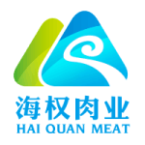
Future developments
01
02
03
04
OPTION
OPTION
OPTION
OPTION
To build premium beef and lamb brand in China for commuters at domestic and international airports all over China with franised stores。
To mix eco-husbandry with food processing without additives – to provide supply to 88 counties and chilled lamb and beef speciality stores
To build our meat business as the largest supplier of fresh – chilled lamb and beef on-line supplier in China
To have our own training centres with a centralized kitchen on a regional and provincial levels with related trade and businesses
。

Slide 16
我们的目的就是IPO，
未来发展目标
01
我们县是国家级贫困县，有绿色通道。
OPTION
02
我们的目的就是IPO。
OPTION
03
我们寻求战略投资合作伙伴，一到三个亿。
OPTION
04
我们不需要财务投资者。
OPTION

Slide 17
结语
“一生鲜草，一碗好肉”，我们的目标是做中国草饲牛羊肉第一家。

Slide 18
2017
Thank you
FOR YOUR ATTENTION
ABOUT
OUR BUSINESS PLAN

